Slide 1
Barcode Reader Database and Inventory System
Carlos Salas | Ada Pluguez

Slide 2
System Description
Our project will keep track of a store’s inventory
Admin Can Update Inventory Product Amounts, Update Product Price, Add New Products, Or Delete Existing Products
Inventory Clerk Can Update Inventory Product Amounts or Lookup Unit Price
Git: https://github.com/adaPlu/Barcode-Reader-CSE111

Slide 3
Use-case
Details
Admin and Inventory Clerk Use Cases:
Look Up Item
Entry Condition: Click Look Up Item
Scan Item
Select Price or Inventory
Display Price or Inventory From Database
Exit Condition: Click Exit
Manage Inventory
Entry Condition: Click Manage Inventory
Scan Item
Select Add or Remove
Enter Amount to be Added or Removed
Edit Inventory Amount in Database
Exit Condition: Click Done
Scanning
Entry Condition: Manage Inventory Scan/Look Up Item Scan
Scan Item
Exit Condition: Item Scanned

Slide 4
Use-Case
Details
Cont.
Admin Only Use Cases:
Update Price
Entry Condition: Click Update Price
Scan Item or Enter bar Code
Enter New Price
Change Price in Database
Exit Condition: Click Done
Add Product
Entry Condition: Click Add Product
Scan Item or Enter Barcode
Enter Product Type
Enter SupplierID
Enter Amount of Product Received
Add Product to Database
Exit Condition: Click Done
Remove Product
Entry Condition: Click Remove Product
Scan Item or Enter Barcode
Remove Product From Database
Exit Condition: Click Done

Slide 5
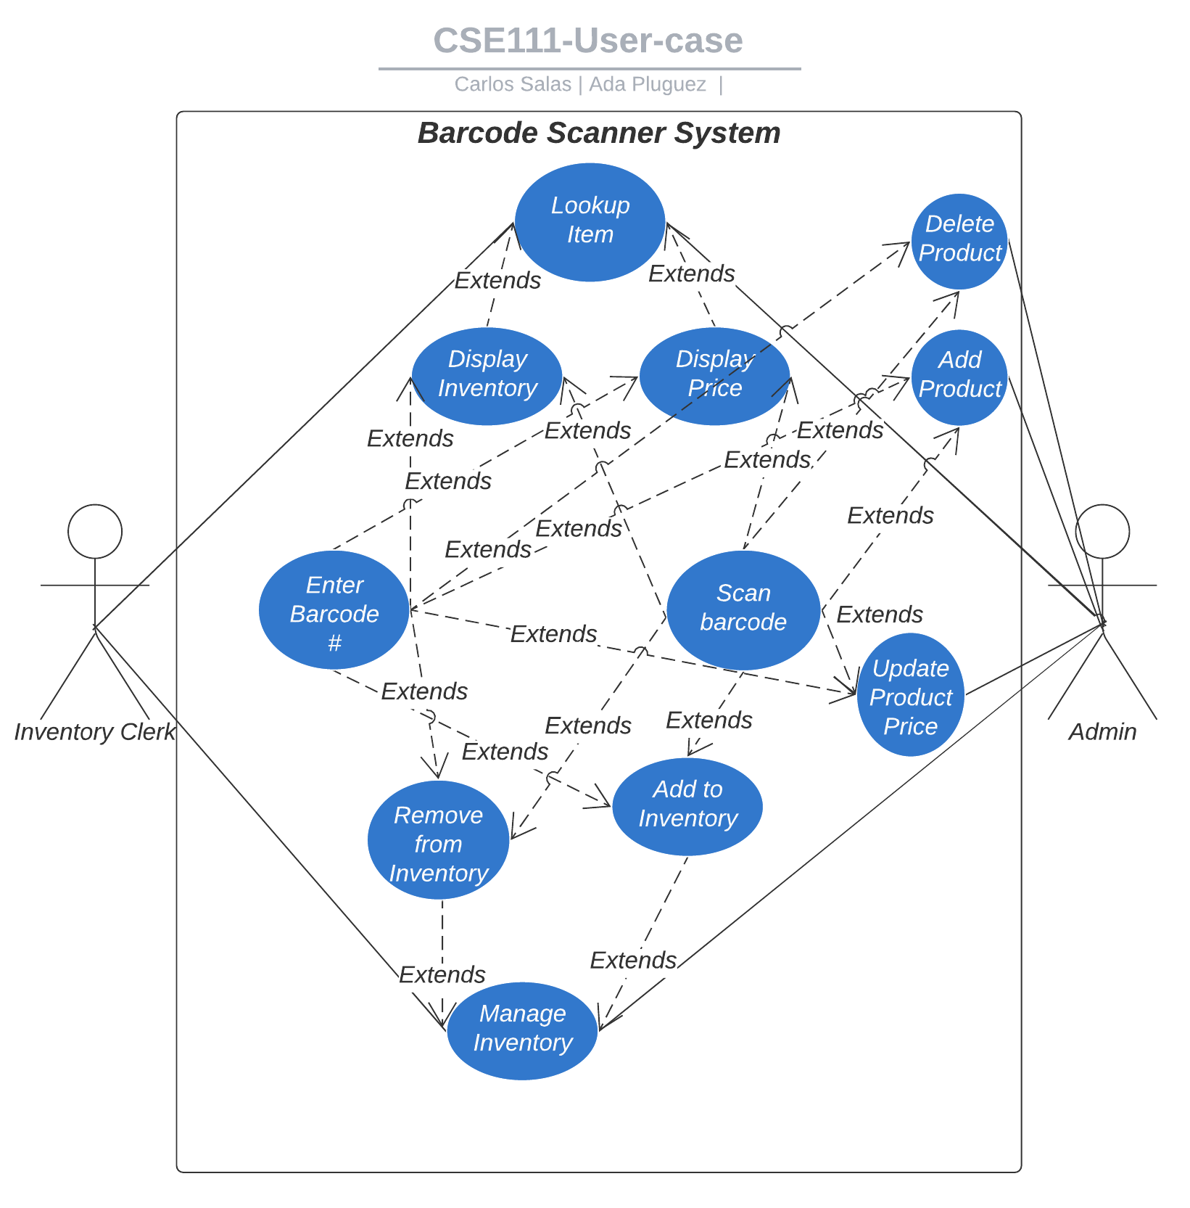
Use-case Diagram

Slide 6
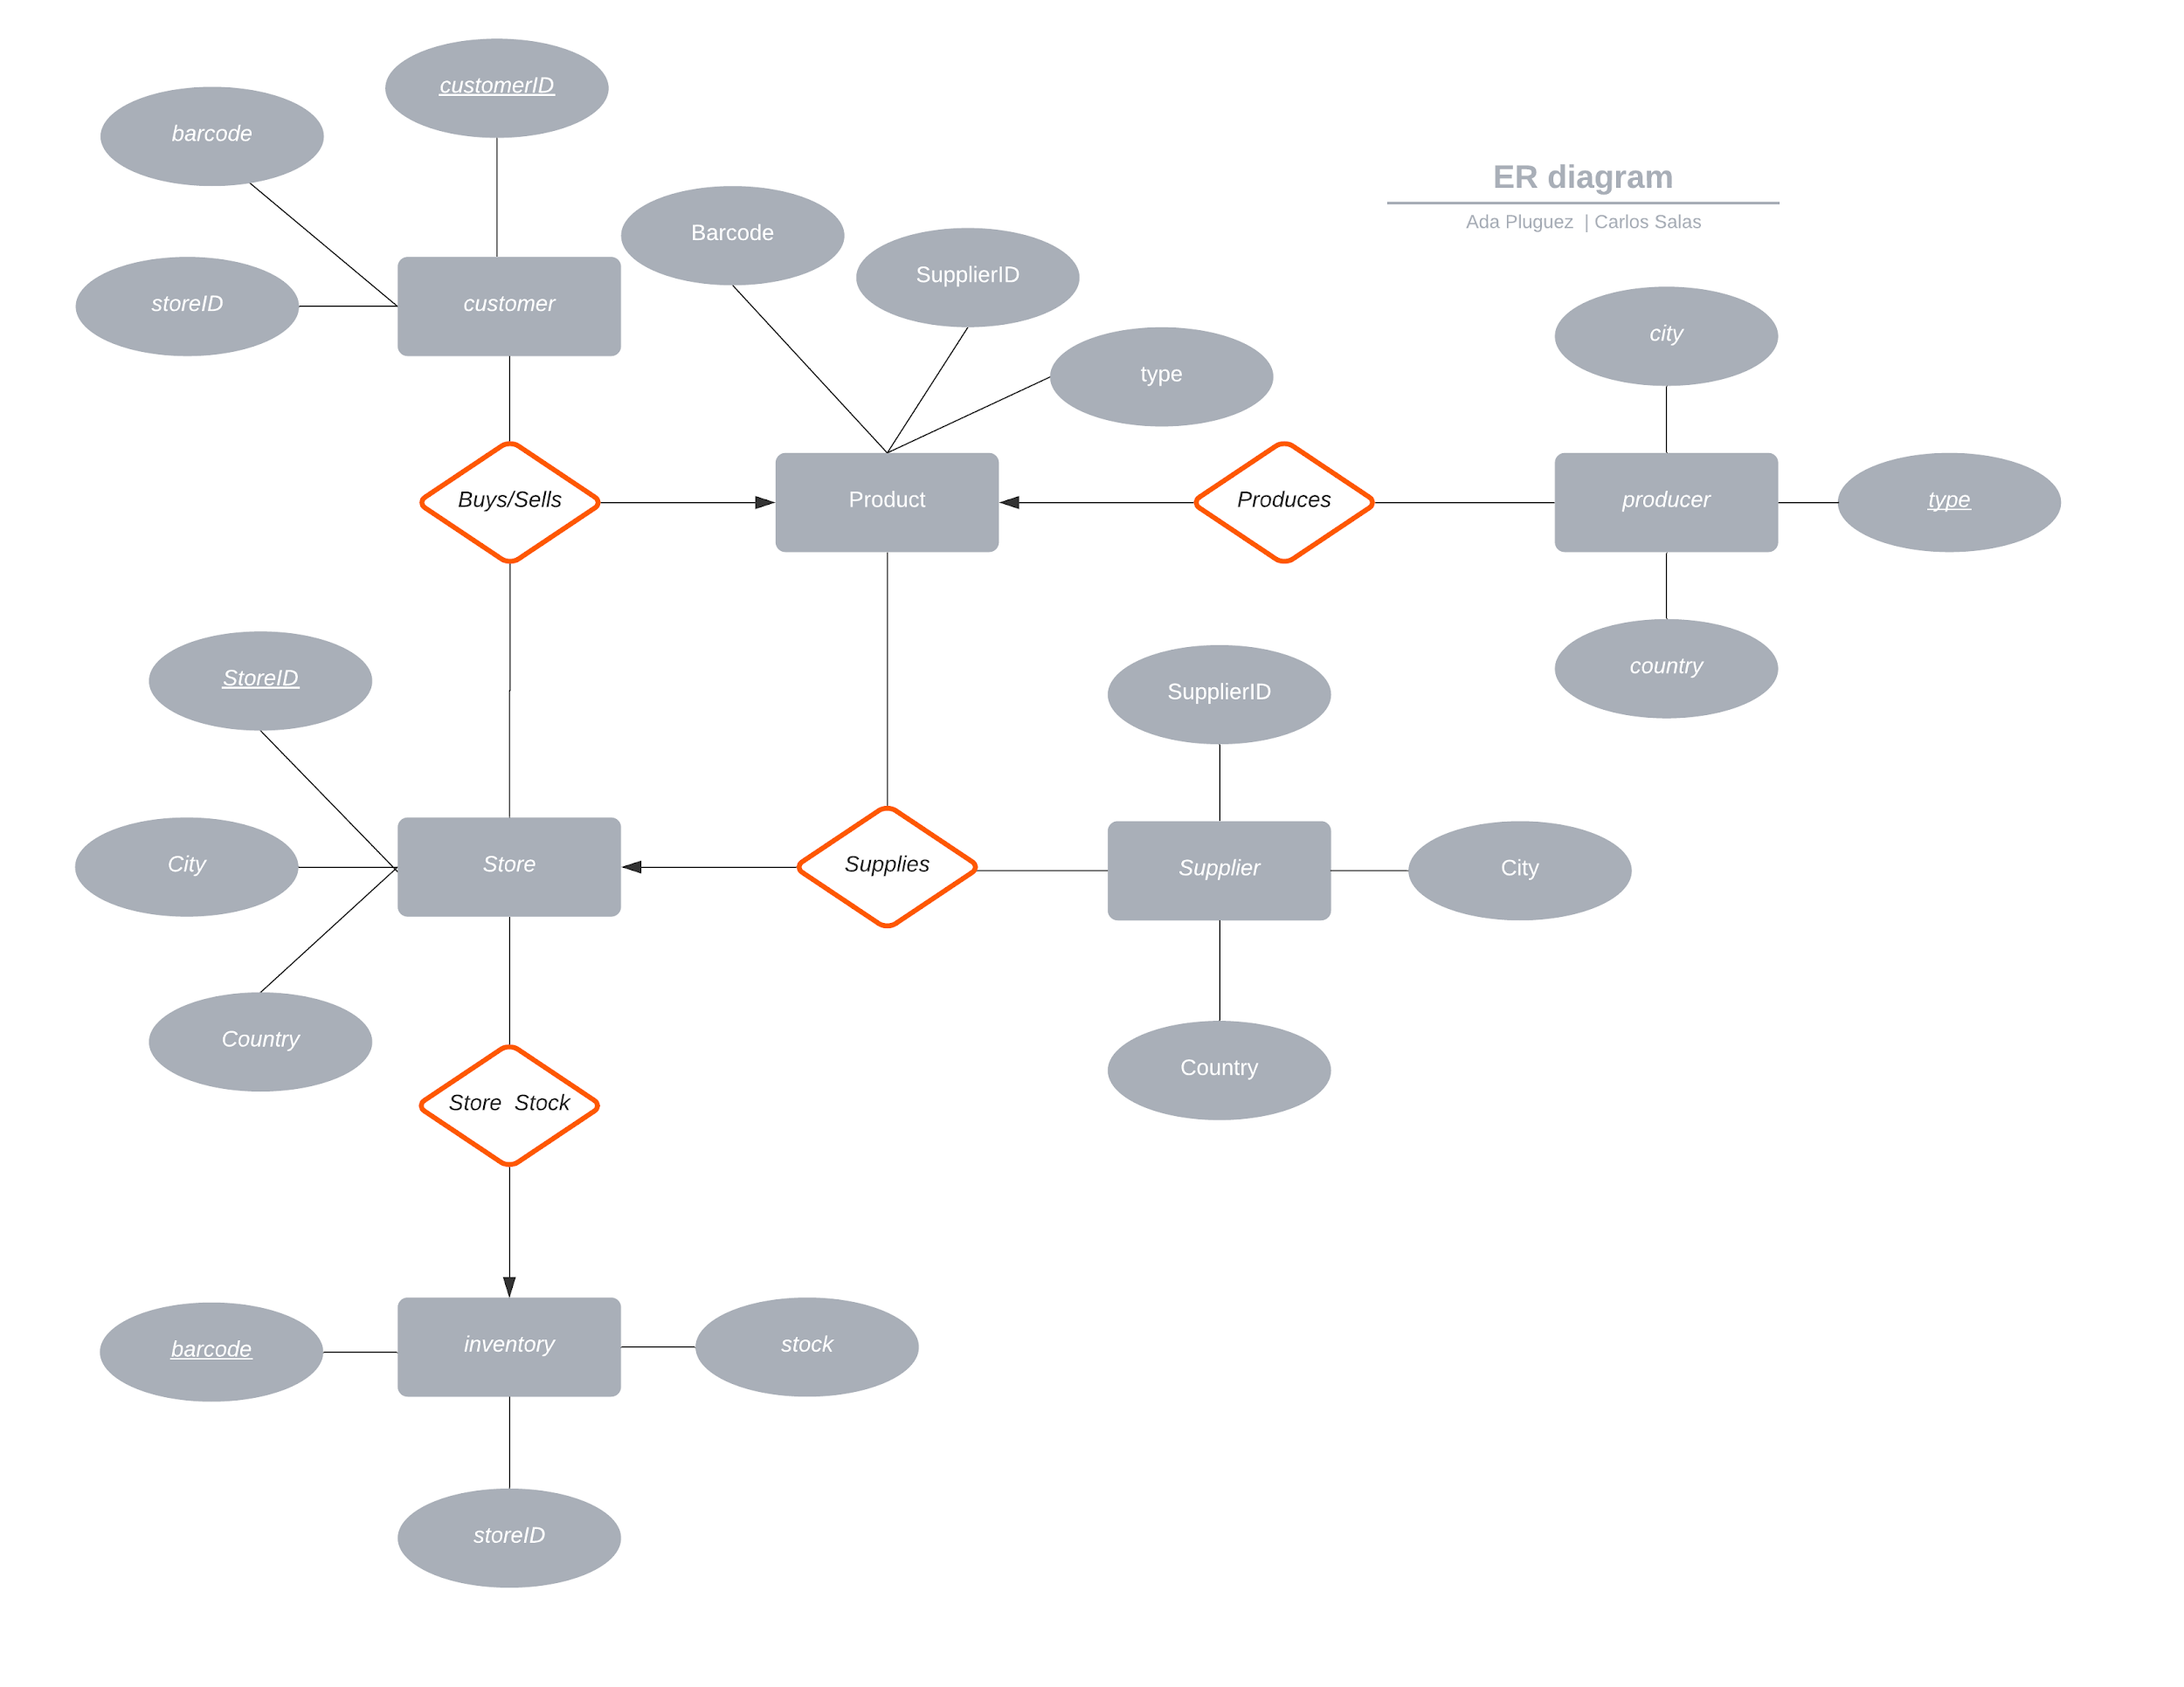
E/R Diagram

Slide 7
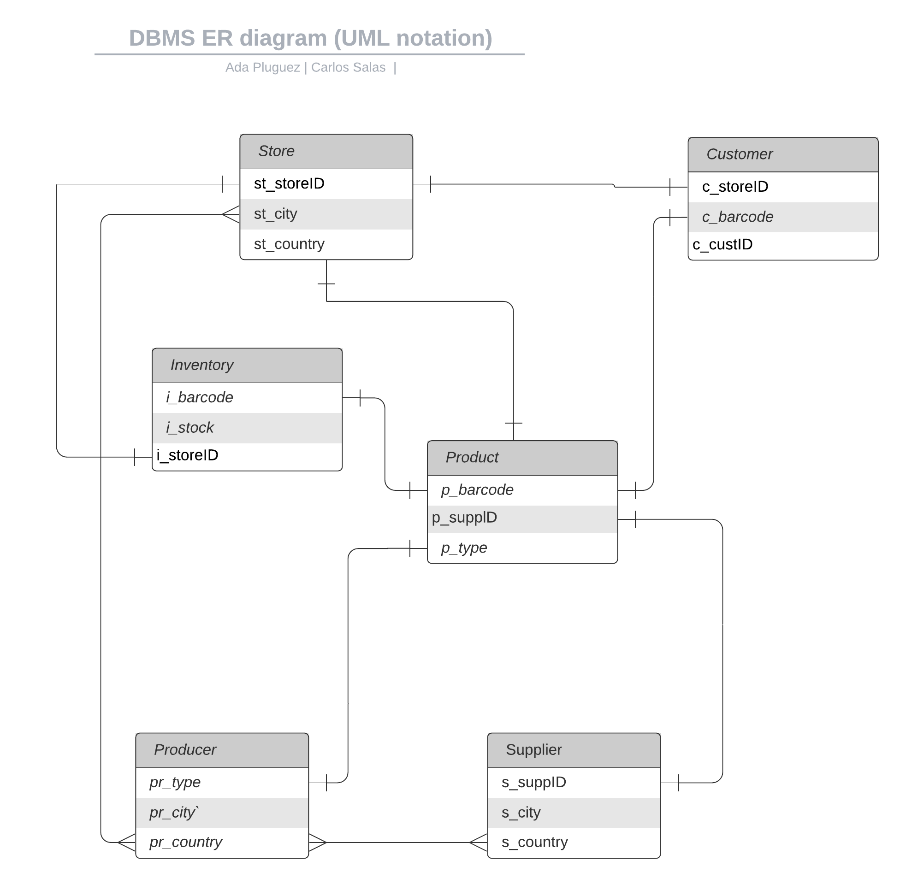
Relational Schema
Inventory
- i_barcode
- i_stock
- i_storeID
Producer
- pr_type
- pr_city
- pr_county
Supplier
- s_supplierID
- s_city
- s_county
Product
- p_barcode
- p_suppliedID
- p_type
Customer
- c_storeID
- c_barcode
- c_customerID
Store
- st_storeID
- st_city
- st_county

Slide 8
Thank You

